Slide 1
Event Driven Programming
Events and Event Handlers | Common Events | Registering Event Handlers | Capturing, at target, and bubbling phases | Preventing Default Behavior |
Notes:
Welcome to our lecture on event driven programming in JS. In this lecture we will go through events and event handlers, common events, registering event handlers, capturing bubble phases, and how to prevent default behavior. Let’s start our lecture.

Slide 2
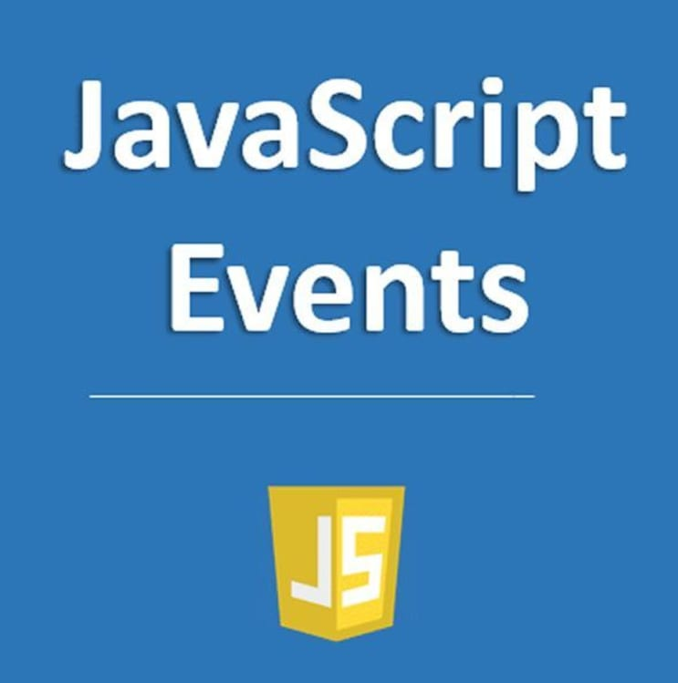
Event and Event Handlers
Event Definition: An event is an action (e.g., mouse movement, key press, network response) that a web browser responds to, often occurring unpredictably.
Event-Driven Programming: A programming style where code (event handlers/listeners) runs in response to events, simplifying web interaction handling.
Browser Event Handling: The browser detects events and executes specified handlers, such as changing an input’s border color when it gains or loses focus.
Notes:
Today, we will discuss events and event handlers in JavaScript. An event is any action a user or system performs, like a mouse click or key press. Event-driven programming enables developers to respond to these actions efficiently. Browsers detect events and execute event handlers, such as changing an input’s border when it gains or loses focus. This approach makes web interactions dynamic and responsive.

Slide 3
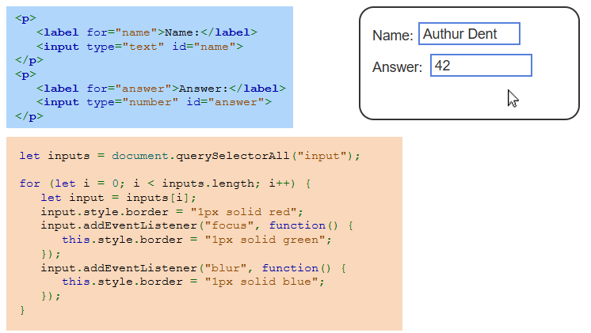
Example
Notes:
This example demonstrates JavaScript event handling. The HTML code creates input fields for name and answer. The JavaScript selects all input elements and sets an initial red border. When an input gains focus, the border turns green. When it loses focus, the border changes to blue. This approach enhances user interaction by visually indicating focus and blur events dynamically.

Slide 4
Common Events
Event Naming: Each event has a specific name representing its action (e.g., mousemove for mouse movement, keydown for a key press).
Mouse Events: Include actions like click, dblclick, mousedown, mouseup, and mousemove.
Keyboard Events: Include keydown, keyup, and keypress to detect user input via the keyboard.
Notes:
Events in JavaScript have specific names based on their actions. Mouse events include click, double click, mouse down, mouse up, and mouse move, which detect user interactions with the mouse. Keyboard events like key down, key up, and key press help track key inputs. Understanding these events is essential for handling user interactions and improving web application responsiveness.

Slide 5
Common Events
The following are events for which web developers commonly write handlers:
A change event is caused by an element value being modified. Ex: Selecting an item in a radio button group causes a change event.
An input event is caused when the value of an input or textarea element is changed.
A load event is caused when the browser completes loading a resource and dependent resources. Usually, load is used with the body element to execute code once all the webpage's CSS, JavaScript, images, etc. have finished loading.
Notes:
Some common events in JavaScript help handle user interactions and page behavior. The change event occurs when an element's value is modified, such as selecting a radio button. The input event triggers when a user types or modifies an input field. The load event fires when a webpage fully loads, ensuring all resources like images and scripts are ready before executing additional code.

Slide 6
Registering event handlers
Embedding Handlers in HTML: Uses attributes like onclick (e.g., <button onclick="clickHandler()">Click Me</button>), but mixes content with functionality and should be avoided.
Setting Event Handlers via JavaScript: Assigning handlers directly to DOM properties (e.g., document.querySelector("#myButton").onclick = clickHandler) allows better separation but limits each element to one handler per event.
Using addEventListener(): Preferred method (e.g., document.querySelector("#myButton").addEventListener("click", clickHandler)) as it keeps content and functionality separate and allows multiple handlers for the same event.
Notes:
There are three ways to register event handlers in JavaScript. Embedding handlers in HTML using attributes like onclick mixes content with functionality and should be avoided. Setting event handlers via JavaScript assigns handlers directly to elements but allows only one per event. The best approach is using add Event Listener, which keeps content separate and allows multiple handlers for the same event.

Slide 7
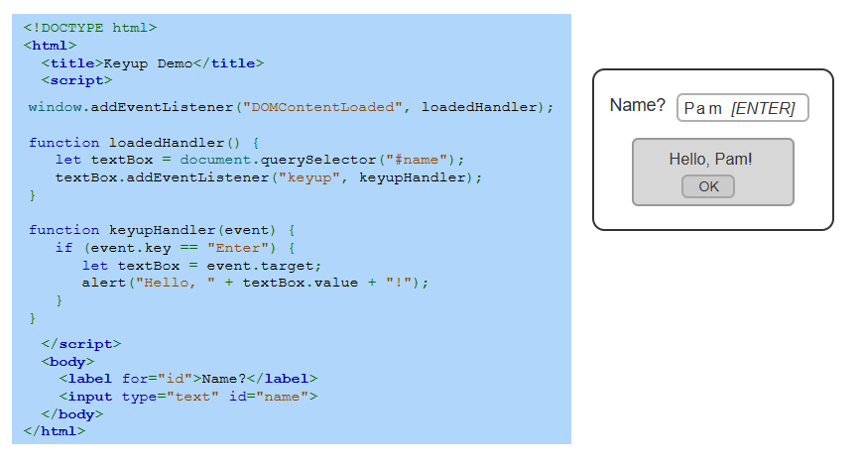
Example
Notes:
This example demonstrates handling the key up event in JavaScript. When the page loads, an event listener is added to the input field. When the user types and presses Enter, a function triggers an alert displaying a greeting with the entered name. This technique improves interactivity by responding to keyboard input, making web applications more dynamic and user-friendly.

Slide 8
Capturing, at target, and bubbling phases
Event Capturing Phase: The browser moves from the root to the event target, calling handlers registered for capturing at each node.
At Target Phase: The browser executes all event-specific handlers on the event's target node.
Event Bubbling Phase: The browser moves from the target node back to the root, calling handlers registered for bubbling at each node.
Notes:
Events in JavaScript follow three phases. In the capturing phase, the event travels from the root to the target element, triggering handlers set for capturing. At the target phase, the event executes on the target element. In the bubbling phase, the event moves back up to the root, triggering handlers set for bubbling. Understanding these phases helps in controlling event behavior effectively.

Slide 9
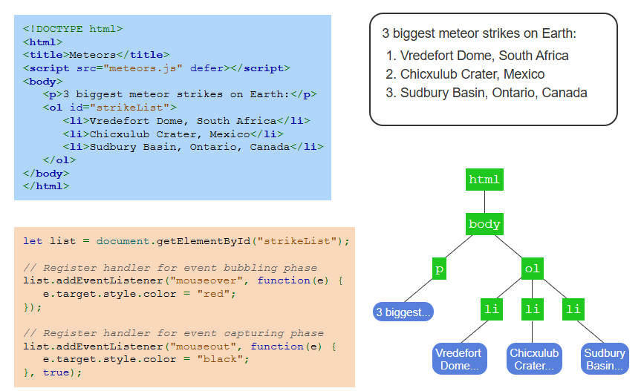
Example
Notes:
This example demonstrates event capturing and bubbling. The HTML lists major meteor strikes, and JavaScript registers event handlers for mouse events. The bubbling phase changes text color to red on hover, while the capturing phase resets it to black. The event hierarchy diagram shows how events travel through the DOM. Understanding these phases helps control event behavior efficiently.

Slide 10
Preventing default behavior
Stopping Event Propagation: Calling stopPropagation() halts event capturing or bubbling but still executes handlers on the current node.
Preventing Default Behavior: preventDefault() stops built-in browser actions (e.g., preventing form submission or disabling space input in a textbox).
Example: A keydown handler (preventSpaces()) prevents spaces in a password field, while an input handler (checkPassword()) evaluates password strength.
Notes:
In JavaScript, we can control event behavior. Calling stop Propagation prevents events from traveling up or down the DOM but still runs handlers on the current node. The prevent Default method stops the browser’s default actions, like form submission or typing spaces in a password field. For example, a key down handler can block spaces, while an input handler can check password strength dynamically. Thanks for watching the lecture.

